Slide 1
Lecture 01
Computer System Fundamentals
Basic Elements · Registers · Instruction Cycle · Interrupts
SENG 21213 · Computer Architecture & Operating Systems
1

Slide 2
Learning Objectives
By the end of this lecture you should be able to:
1. Identify the four basic computer components and describe the role of each
2. Explain the function of MAR, MBR, I/OAR and I/OBR using register-transfer notation
3. Trace a program execution step-by-step through the fetch-execute cycle
4. Classify instructions into four categories: processor-memory, processor-I/O, data processing, control
5. Describe the complete 9-step interrupt processing sequence from IRQ to ISR return
6. Compare sequential and nested multiple-interrupt strategies with their trade-offs
SENG 21213 · Computer Architecture & Operating Systems
2

Slide 3
Section 1
The Four Basic Elements
3

Slide 4
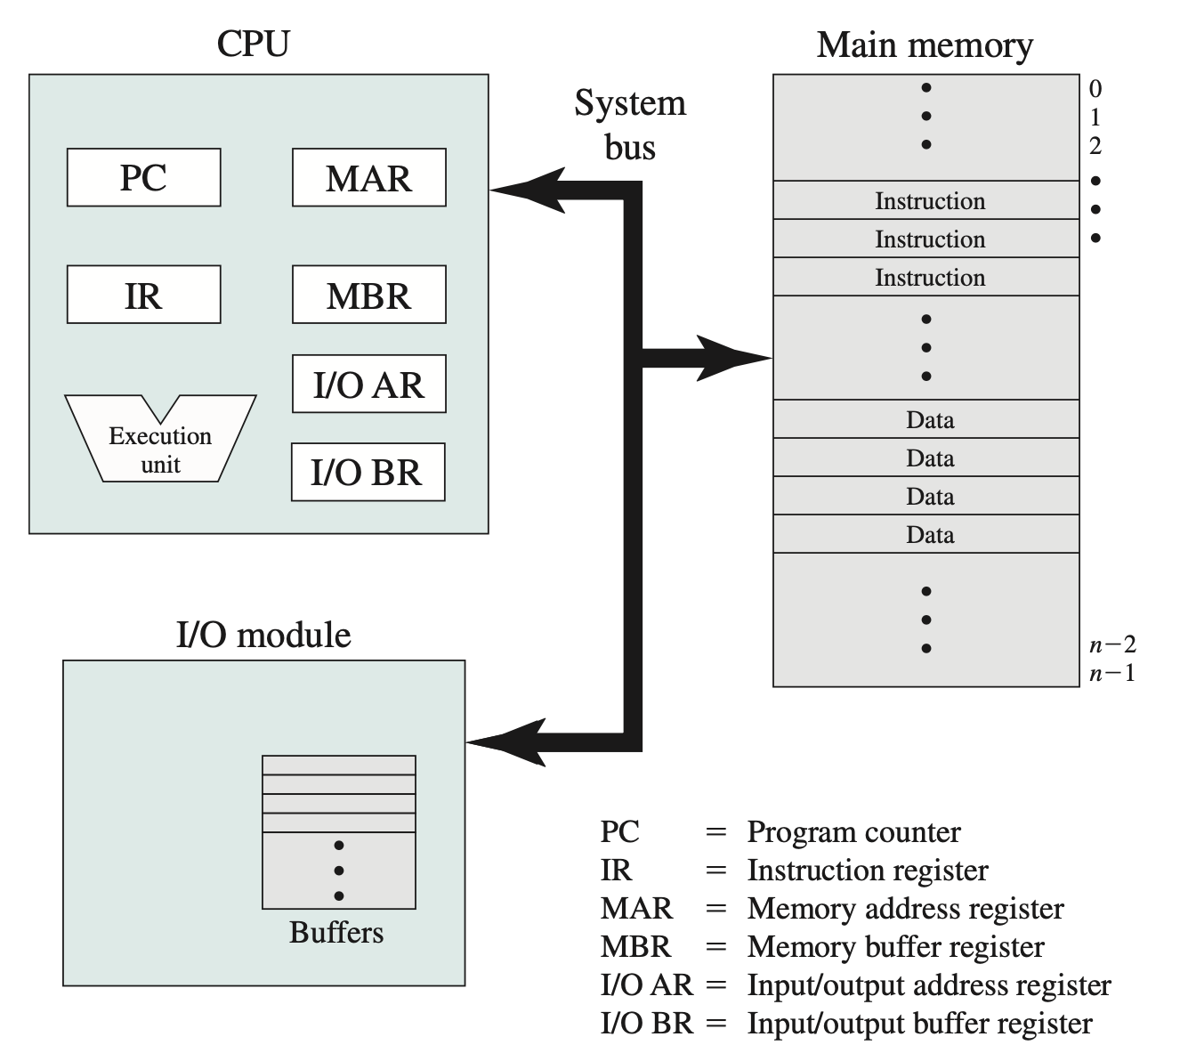
Top-Level View of Computer Components
CPU, Main Memory, I/O Modules, and System Bus — the four building blocks of every computer system (Stallings Fig. 1.1)
SENG 21213 · Computer Architecture & Operating Systems
4

Slide 5
The Four Basic Elements
Component | Function | Key Characteristics
Processor (CPU) | Controls operations; performs data processing | Contains ALU and CU; executes instruction cycle; single or multi-core
Main Memory | Stores instructions and data currently in use | Volatile; byte/word addressable; also called RAM or primary memory
I/O Modules | Transfer data between computer and external devices | Contains data buffers; examples: disk controller, NIC, keyboard controller
System Bus | Communication pathway between all components | Carries address, data, and control signals; shared resource with arbitration
SENG 21213 · Computer Architecture & Operating Systems
5

Slide 6
Section 2
CPU Registers & Instruction Cycle
6

Slide 7
Four Key CPU Registers
Register | Full Name | Role
MAR | Memory Address Register | Holds address of next memory read/write — CPU sets this before any memory access
MBR | Memory Buffer Register | Holds data just read from or about to be written to memory — acts as a buffer
I/OAR | I/O Address Register | Specifies which I/O device (port address) the current transfer targets
I/OBR | I/O Buffer Register | Holds data exchanged between CPU and the selected I/O module
SENG 21213 · Computer Architecture & Operating Systems
7

Slide 8
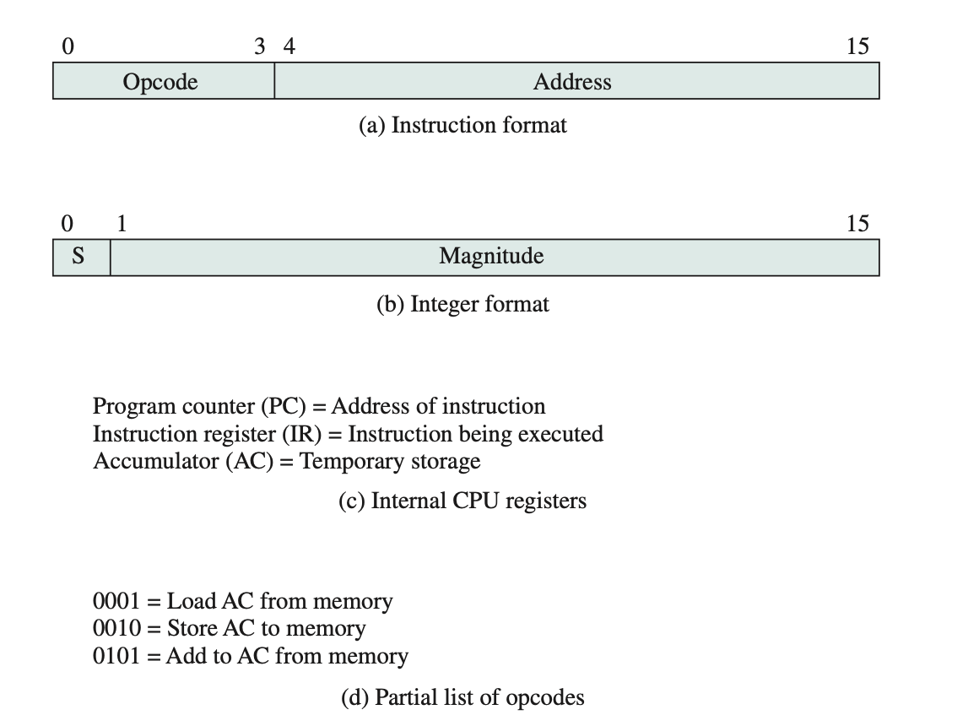
The Fetch-Execute Cycle
Two-phase instruction cycle: FETCH (load next instruction) → EXECUTE (carry out the operation) — repeats until HALT (Stallings Fig. 1.2)
SENG 21213 · Computer Architecture & Operating Systems
8

Slide 9
Fetch Stage — Five Micro-Operations
MAR ← PC (copy Program Counter to Memory Address Register)
MBR ← Memory[MAR] (read instruction word from memory into MBR)
IR ← MBR (copy instruction to Instruction Register for decoding)
PC ← PC + 1 (advance Program Counter to next instruction)
Decode: Control Unit reads opcode from IR[15:12] to determine instruction type
SENG 21213 · Computer Architecture & Operating Systems
9

Slide 10
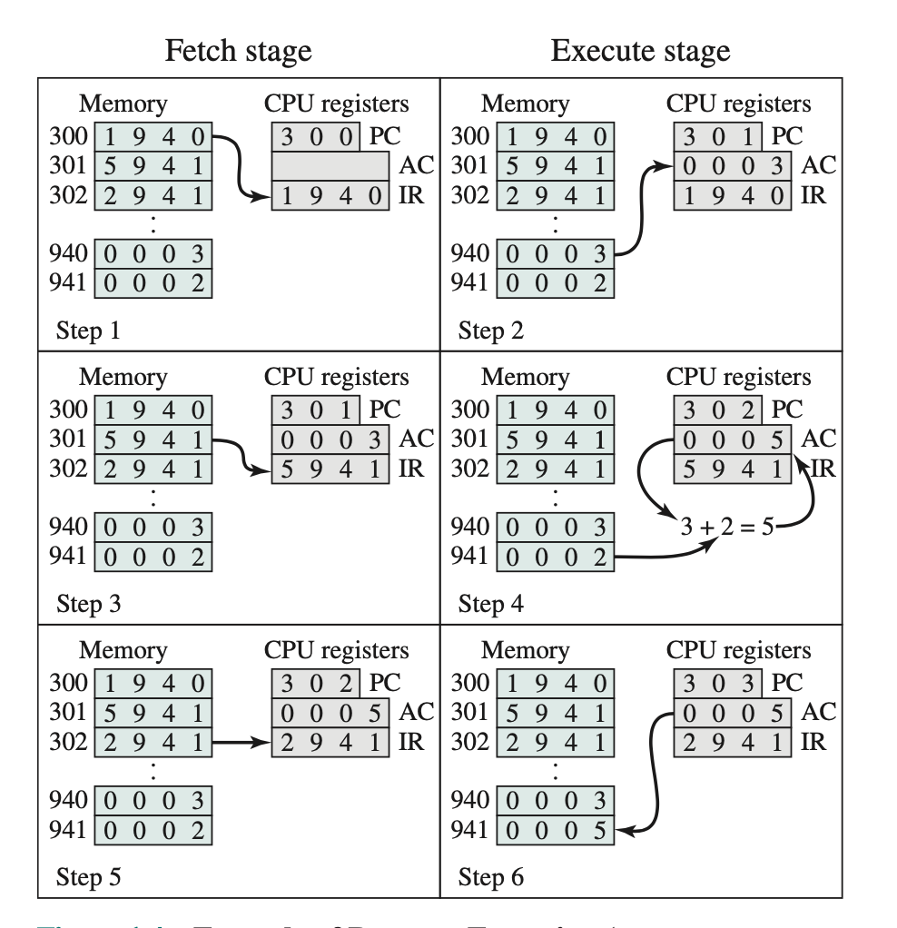
Instruction Format — Opcode + Address
4-bit opcode (one hex digit) | 12-bit address (three hex digits) — 1940 hex = opcode 1 (LOAD), address 940 (Stallings Fig. 1.4)
SENG 21213 · Computer Architecture & Operating Systems
10

Slide 11
Four Instruction Categories
Category | Description | Example
Processor-Memory | Data transferred between CPU and main memory | LOAD AC from Memory[940]; STORE AC to Memory[941]
Processor-I/O | Data transferred between CPU and I/O module | READ from keyboard port; WRITE to serial port
Data Processing | ALU performs arithmetic or logic on registers | ADD AC with Memory[941]; AND AC with bitmask value
Control | Instruction alters the Program Counter — branch/jump | JMP 182 (unconditional); BEQ label (conditional)
SENG 21213 · Computer Architecture & Operating Systems
11

Slide 12
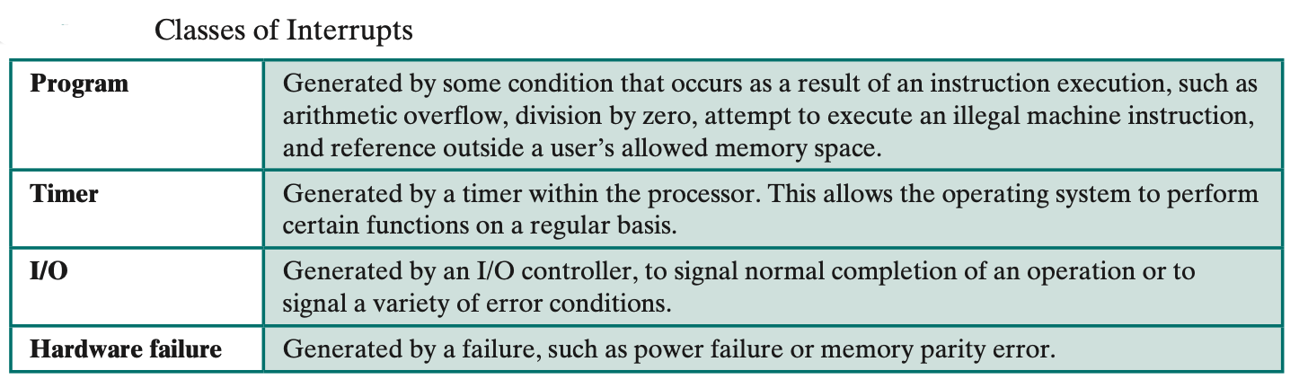
Complete Execution Trace — Stallings Fig. 1.3
Step-by-step trace: LOAD 940 → ADD 941 → STORE 941 showing PC, MAR, MBR, IR, AC at each step
SENG 21213 · Computer Architecture & Operating Systems
12

Slide 13
Common Mistake — PC Increment Timing
⚠ PC Increments During FETCH, Not After Execute
The PC is incremented in step 4 of the FETCH stage (PC ← PC + 1)
By the time EXECUTE begins, the PC already points to the NEXT instruction
This enables the CPU to begin fetching the next instruction during execute (pipelining)
Exam trap: "what does PC contain during execute of instruction at address 300?" → Answer: 301
SENG 21213 · Computer Architecture & Operating Systems
13

Slide 14
Section 3
Interrupts
14

Slide 15
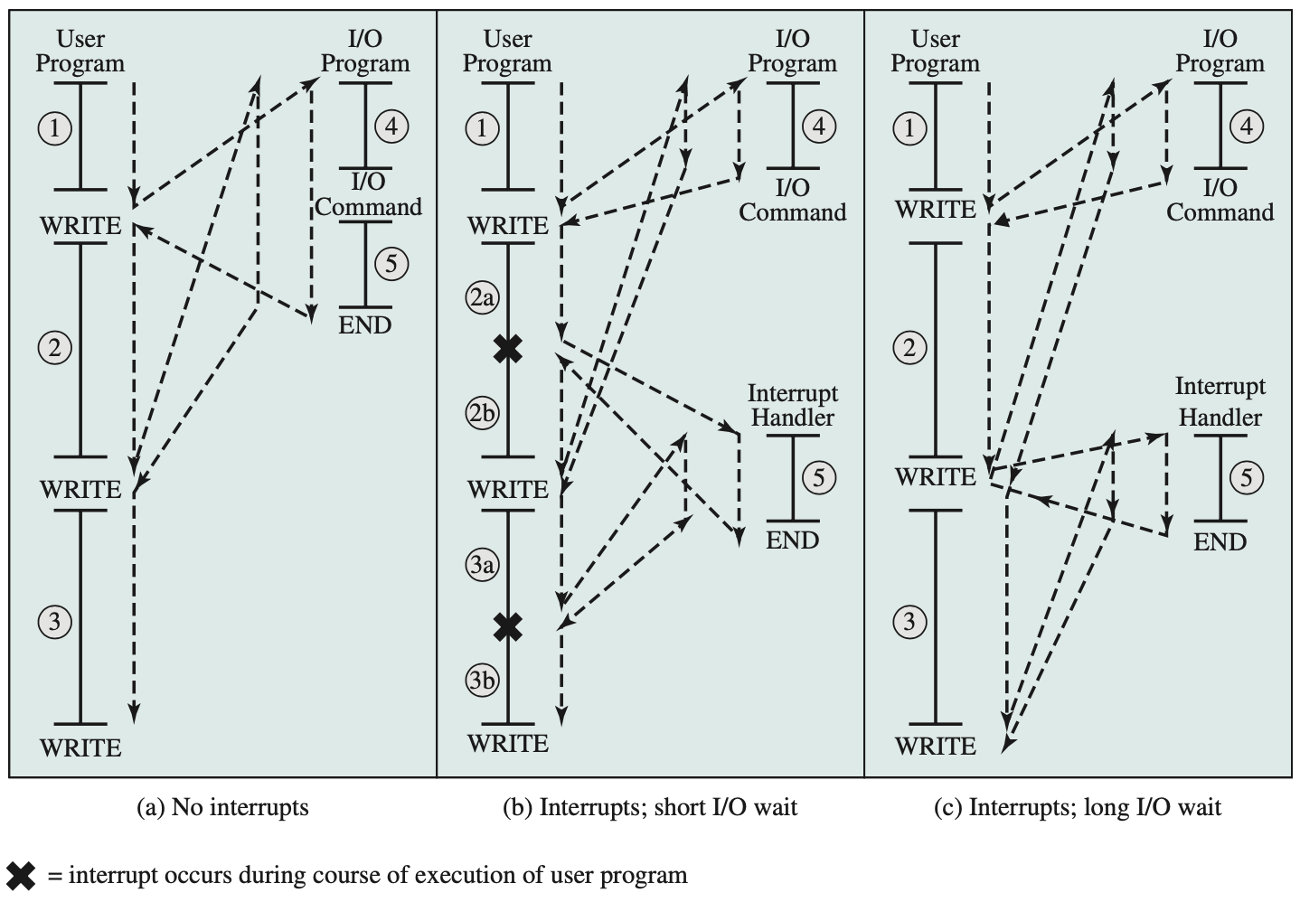
Why Interrupts? — The Motivation
Without interrupts: CPU must POLL devices in a tight loop (Programmed I/O)
A 1 GHz CPU doing 1 I/O operation per 4 ms wastes 4,000,000 cycles spinning
Interrupts allow the CPU to execute useful work while I/O proceeds in background
When device finishes: it asserts an IRQ signal → CPU runs a short ISR → resumes
Result: CPU utilisation improves from ~30% to >90% on I/O-bound workloads
SENG 21213 · Computer Architecture & Operating Systems
15

Slide 16
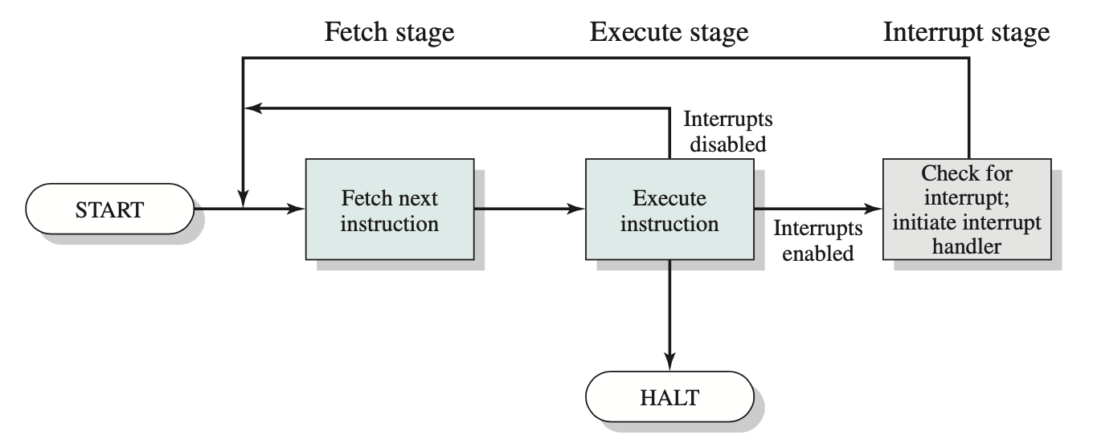
Extended Instruction Cycle with Interrupt Check
After each Execute stage, the CPU checks for pending interrupts before fetching the next instruction (Stallings Fig. 1.8)
SENG 21213 · Computer Architecture & Operating Systems
16

Slide 17
9-Step Interrupt Processing Sequence
Step | Who | Action
1 | Device | Asserts IRQ signal on interrupt bus to CPU
2 | CPU | Finishes current instruction completely — no mid-instruction interrupts
3 | CPU → Device | CPU asserts interrupt acknowledge; device removes IRQ
4 | CPU | Saves PSW + PC onto kernel control stack (minimum context)
5 | CPU | Loads PC from Interrupt Vector Table entry for this interrupt type
6 | ISR | Saves ALL general registers (EAX–EDI, EBP) — ISR will use them
7 | ISR | Services the interrupt: reads device status, transfers data
8 | ISR | Restores all saved general registers (reverse of step 6)
9 | ISR | Restores PSW + PC from stack; CPU resumes interrupted program
SENG 21213 · Computer Architecture & Operating Systems
17

Slide 18
Multiple Interrupts — Two Strategies
Sequential (Disable Interrupts)
Nested (Priority-Based)
CPU sets interrupt-disable flag during ISR
New IRQs held pending until re-enable
ISRs run to completion — no nesting
Simple; no stack overflow risk
Problem: slow ISRs delay time-critical events
ISRs run at a priority level
Higher-priority IRQ interrupts lower ISR
Time-critical events handled immediately
Requires nested stack of saved contexts
Problem: stack overflow if too many levels
SENG 21213 · Computer Architecture & Operating Systems
18

Slide 19
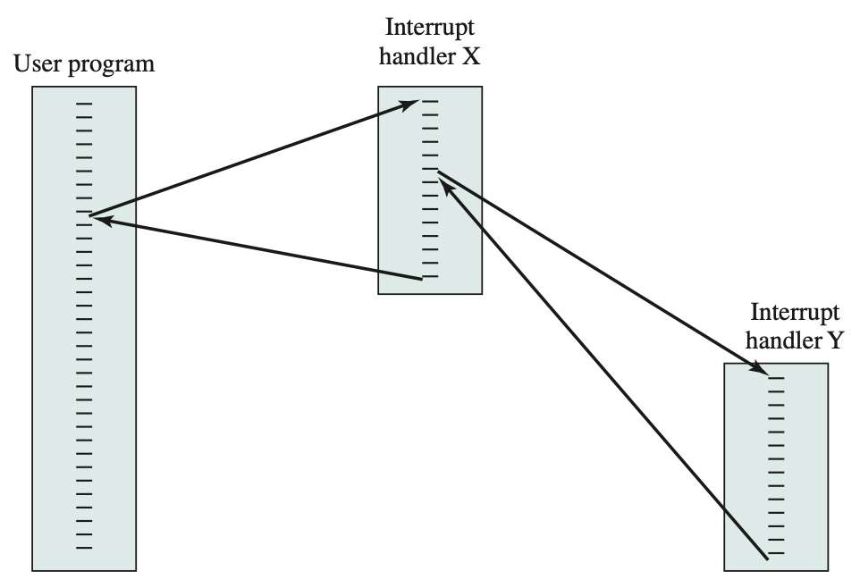
Nested Interrupt Processing
Multiple interrupt sources with different priorities — higher priority ISR preempts lower priority ISR mid-execution (Stallings Fig. 1.12)
SENG 21213 · Computer Architecture & Operating Systems
19

Slide 20
Practice Exercise
✎ Exercise 1.1 — Instruction Trace [10 marks]
A processor executes: (1) LOAD AC from Memory[940], (2) ADD Memory[941], (3) STORE to Memory[941]
(a) [4] Draw the complete 6-step execution trace showing PC, MAR, MBR, IR, AC at each step
(b) [3] Write the three 16-bit instruction words as 4-digit hex (opcode 1=LOAD, 5=ADD, 2=STORE)
(c) [3] At what point during the trace is the PC updated to point to instruction 2? Explain why
SENG 21213 · Computer Architecture & Operating Systems
20

Slide 21
Key Takeaways
Computer System Fundamentals
Four basic elements: Processor, Main Memory, I/O Modules, System Bus
MAR holds address; MBR holds data — every memory access uses both
Fetch: MAR←PC; MBR←Memory[MAR]; IR←MBR; PC←PC+1; then decode
Four instruction categories: processor-memory, I/O, data processing, control
9-step interrupt: IRQ → finish instruction → acknowledge → save context → ISR → restore
Sequential vs. nested interrupts: simplicity vs. responsiveness trade-off
21

