Slide 1
Lecture 02
Memory Hierarchy & I/O Architecture
Memory Hierarchy · Hit Ratio · Cache Design · DMA · Multicore
SENG 21213 · Computer Architecture & Operating Systems
1

Slide 2
Learning Objectives
By the end of this lecture you should be able to:
1. Apply the hit ratio formula to compute average memory access time for a two-level hierarchy
2. Describe temporal and spatial locality and explain how caches exploit both
3. Compare direct, set-associative, and fully associative cache mapping functions
4. Distinguish programmed I/O, interrupt-driven I/O, and DMA by CPU involvement and interrupt count
5. Trace the 7-step DMA transfer process from CPU programming the controller to completion interrupt
6. Explain SMP and multicore architectures and identify cache coherence as a key design challenge
SENG 21213 · Computer Architecture & Operating Systems
2

Slide 3
Section 1
The Memory Hierarchy
3

Slide 4
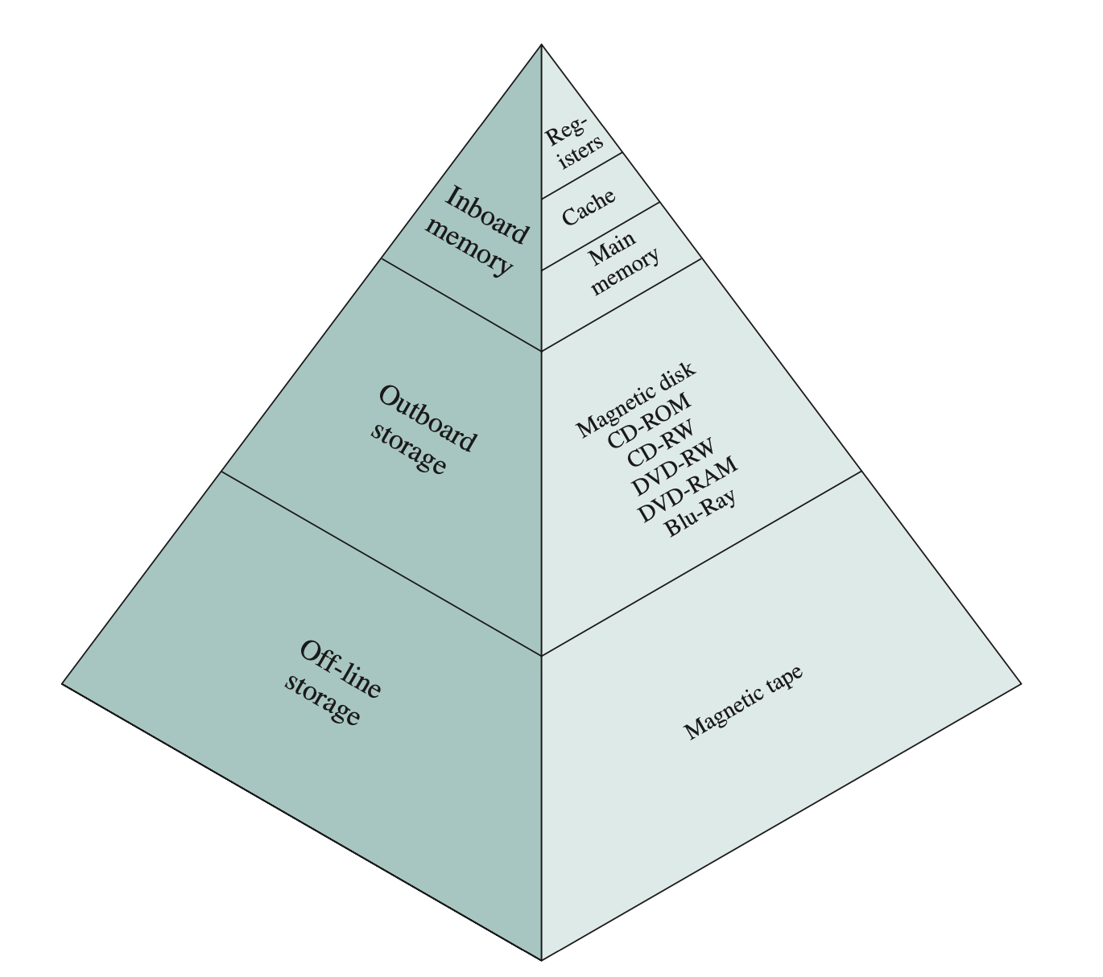
The Memory Hierarchy
Speed decreases and capacity increases moving down — CPU registers → L1/L2/L3 cache → RAM → SSD → HDD → Tape (Stallings Fig. 1.13)
SENG 21213 · Computer Architecture & Operating Systems
4

Slide 5
Memory Hierarchy Trade-offs
Level | Technology | Typical Size | Typical Latency | Cost/Bit
Registers | SRAM (flip-flops) | 32–512 bytes | 0–1 cycles | Very high
L1 Cache | SRAM | 32–64 KB | 1–4 cycles | High
L2 Cache | SRAM | 256 KB – 4 MB | 10–15 cycles | Medium-high
L3 Cache | SRAM (shared) | 4–64 MB | 30–50 cycles | Medium
Main Memory (RAM) | DRAM | 4–512 GB | 60–100 ns | Low
SSD | NAND Flash | 256 GB – 8 TB | 100 µs | Very low
HDD | Magnetic disk | 1–20 TB | 5–10 ms | Extremely low
SENG 21213 · Computer Architecture & Operating Systems
5

Slide 6
Hit Ratio Formula
★ Two-Level Memory — Hit Ratio and Average Access Time
T_avg = H × T₁ + (1 − H) × (T₁ + T₂) = T₁ + (1 − H) × T₂
H = hit ratio = fraction of accesses served by the cache
T₁ = cache access time; T₂ = main memory access time
Example: H = 0.95, T₁ = 0.1 µs, T₂ = 1.0 µs
→ T_avg = 0.1 + (1 − 0.95) × 1.0 = 0.1 + 0.05 = 0.150 µs
→ Speedup over no cache = 1.0 / 0.150 = 6.67× faster access
SENG 21213 · Computer Architecture & Operating Systems
6

Slide 7
Section 2
Cache Memory Design
7

Slide 8
Principles of Locality
Temporal Locality
Spatial Locality
A recently accessed location will likely be accessed again soon
Example: a loop variable accessed 10,000 times in a tight loop
Cache exploits this by keeping recently used items resident
LRU replacement maximises temporal locality benefit
If address X is accessed, addresses near X are likely accessed soon
Example: iterating through an array element by element
Cache exploits this by loading entire cache lines (64 bytes on x86)
Prefetching further exploits spatial locality patterns
SENG 21213 · Computer Architecture & Operating Systems
8

Slide 9
Cache Design Parameters
Parameter | Options | Performance Impact
Cache size | L1: 32–64 KB; L2: 256KB–4MB; L3: 4–64MB | Larger → higher hit ratio, but slower access and higher cost
Block (line) size | Typically 32–128 bytes | Larger → exploits spatial locality; larger miss penalty
Mapping function | Direct, Set-associative (k-way), Fully associative | See next slide — affects conflict miss rate vs. hardware cost
Replacement policy | LRU, Clock, Random, FIFO | LRU near-optimal; Clock is practical approximation
Write policy | Write-through or Write-back | Write-back reduces bus traffic; needs dirty bit per cache line
Number of levels | L1 (private), L2 (private), L3 (shared) | Multiple levels balance latency and capacity trade-offs
SENG 21213 · Computer Architecture & Operating Systems
9

Slide 10
Cache Mapping Functions
Mapping | How It Works | Conflict Miss Risk | Hardware Cost
Direct | Block i maps to exactly one line: i mod N | High — two hot blocks can evict each other repeatedly | Low — one comparator
k-way Set-Associative | Cache has S sets of k lines; block i → set i mod S; any of k lines within that set | Moderate — k blocks compete per set | Medium — k comparators per set
Fully Associative | Block can go into ANY cache line; no fixed mapping | Minimal — only capacity misses | High — one comparator per line; impractical for large caches
SENG 21213 · Computer Architecture & Operating Systems
10

Slide 11
Section 3
I/O Techniques
11

Slide 12
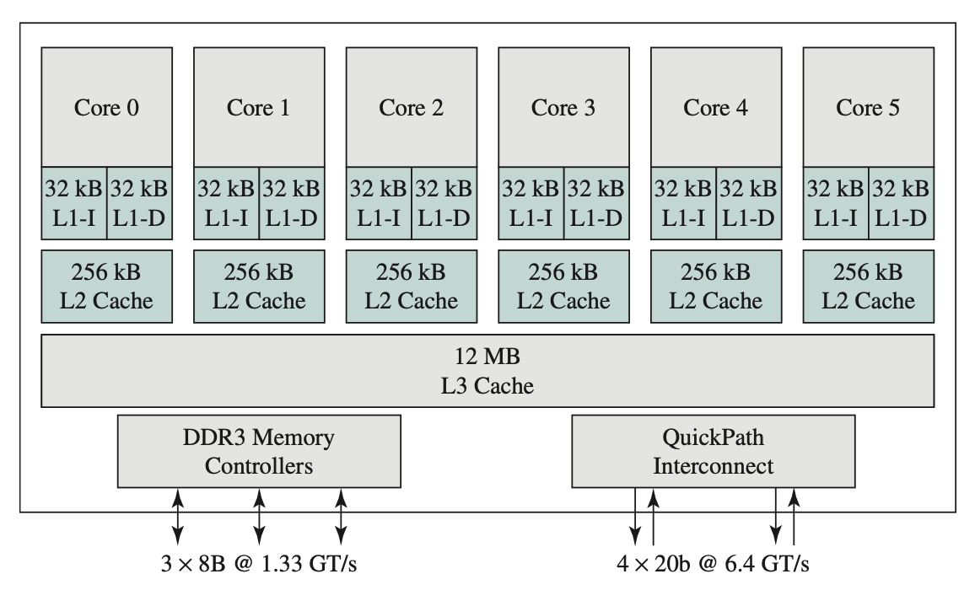
Three I/O Techniques Compared
Programmed I/O vs. Interrupt-Driven I/O vs. DMA — CPU involvement decreases with each technique (Stallings Fig. 1.17)
SENG 21213 · Computer Architecture & Operating Systems
12

Slide 13
I/O Technique Comparison
Technique | CPU Role | Interrupts per MB | Best Use Case
Programmed I/O | 100% — CPU polls status register every byte; blocks on I/O | 0 (no interrupts — pure busy-wait) | Very fast tiny transfers; embedded with no interrupt hardware
Interrupt-Driven | CPU issues command then runs; ISR handles each byte/word | ~1,000,000 per MB at 1 byte/interrupt | Slow devices with infrequent transfers: keyboard, mouse, serial
DMA | CPU sets up controller; DMA handles entire block; 1 interrupt at end | 1 per block (regardless of size!) | High-speed bulk transfer: disk, NIC, GPU — the standard for all storage I/O
SENG 21213 · Computer Architecture & Operating Systems
13

Slide 14
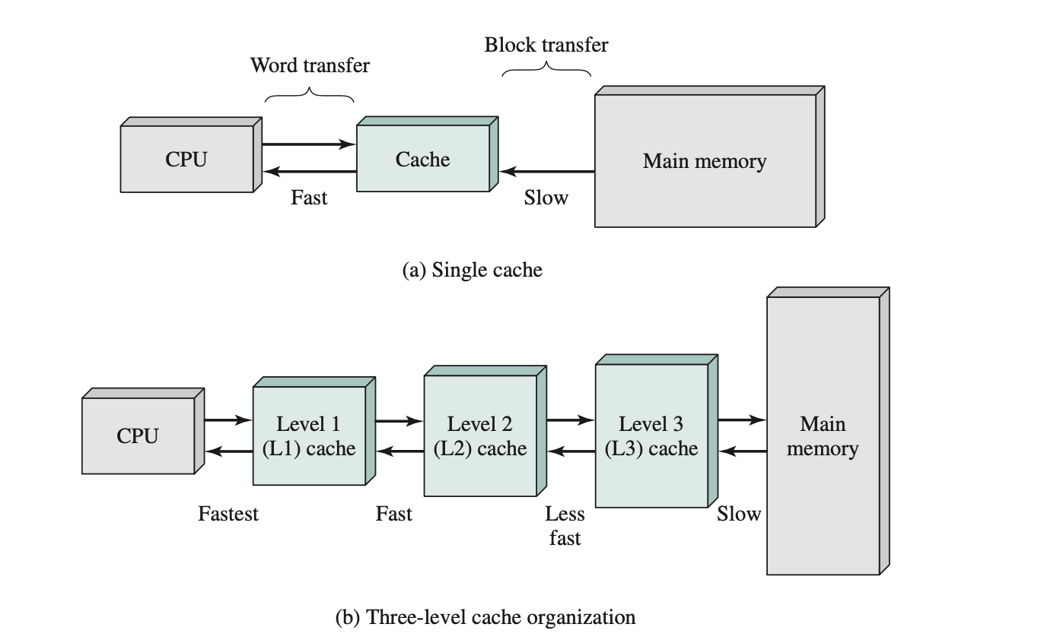
DMA Controller Architecture
DMA controller moves data using cycle-stealing — takes the bus one cycle at a time while allowing the CPU to execute between cycles (Stallings Fig. 1.18)
SENG 21213 · Computer Architecture & Operating Systems
14

Slide 15
DMA Transfer — 7 Steps
1. CPU programs DMA: source/dest address, byte count, direction, device ID
2. CPU issues GO command — immediately returns to user/OS code
3. DMA requests bus from arbiter (cycle stealing)
4. DMA transfers one word between device and memory
5. DMA releases bus one cycle → CPU executes; DMA steals next cycle
6. Steps 3–5 repeat until byte count = 0
7. DMA raises completion interrupt → brief ISR updates bookkeeping
SENG 21213 · Computer Architecture & Operating Systems
15

Slide 16
Section 4
Multiprocessor & Multicore
16

Slide 17
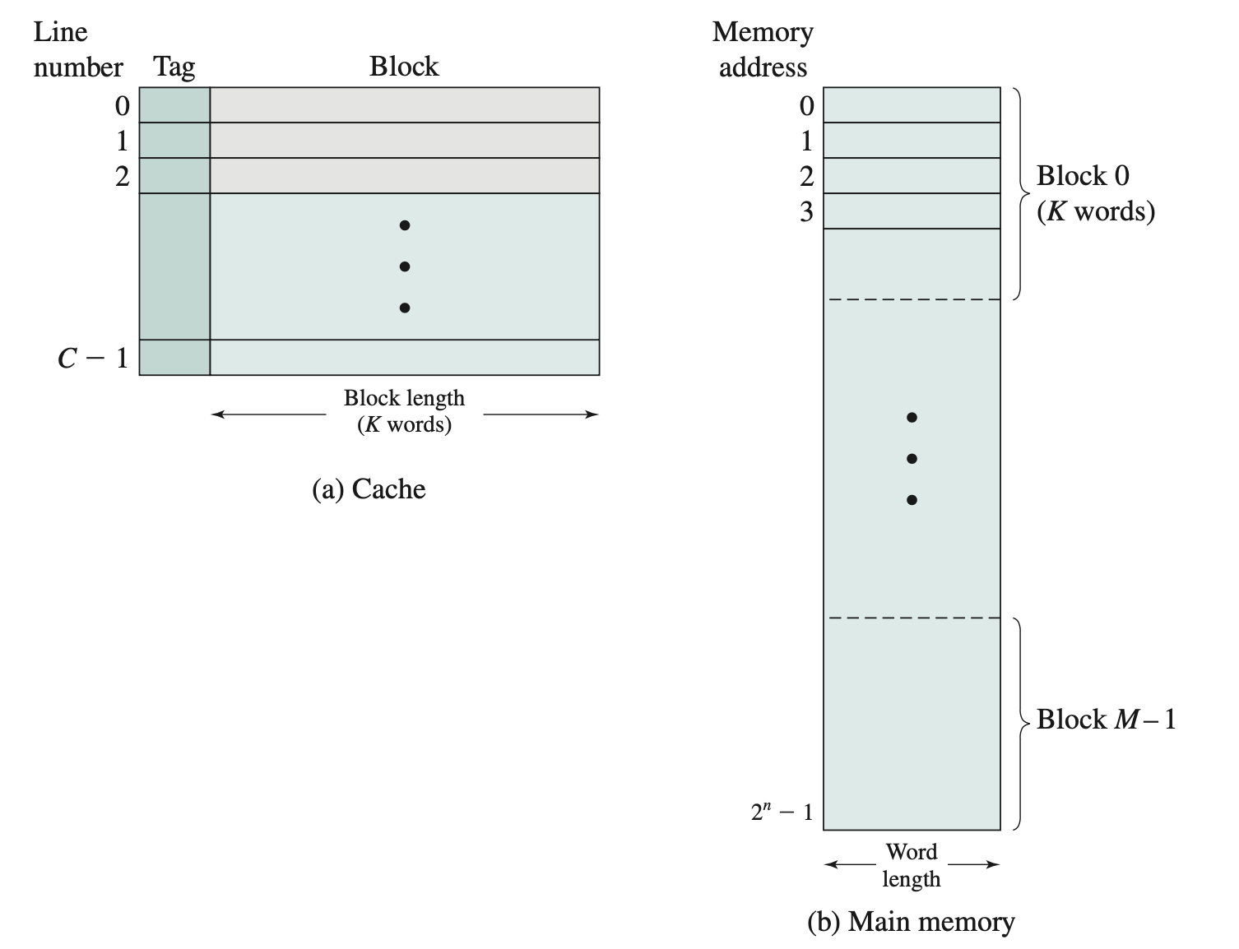
SMP Architecture
Symmetric Multiprocessing: multiple processors sharing memory and I/O via common bus — all processors equal access to all resources (Stallings Fig. 1.20)
SENG 21213 · Computer Architecture & Operating Systems
17

Slide 18
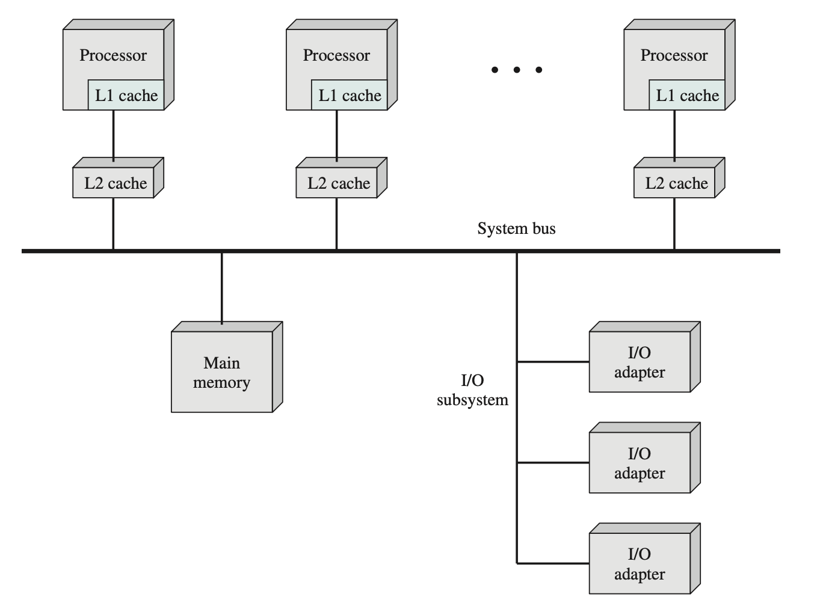
Intel Core i7 — Multicore Die
6 cores each with private L1/L2 cache; shared L3 cache on-die; integrated memory controller (Stallings Fig. 1.22)
SENG 21213 · Computer Architecture & Operating Systems
18

Slide 19
Cache Coherence Problem
⚠ MESI Protocol — Keeping Caches Consistent
Problem: Core 0 writes to address X; Core 1 still holds a STALE copy in its L1 cache
MESI protocol tracks each cache line state: Modified / Exclusive / Shared / Invalid
Modified: only this core has the line; it is dirty (differs from memory)
Exclusive: only this core has it; clean copy
Shared: multiple cores have a clean copy — any core can read freely
Invalid: this core's copy is stale — must fetch before next use
SENG 21213 · Computer Architecture & Operating Systems
19

Slide 20
Practice Exercise
✎ Exercise 2.1 — Hit Ratio Calculation [8 marks]
T₁ = 0.5 ns (cache), T₂ = 50 ns (main memory), block size = 64 bytes
(a) [2] What hit ratio H is needed to achieve T_avg = 2 ns? Show algebraic working.
(b) [2] If H increases from 0.90 to 0.98, by what factor does T_avg improve?
(c) [4] Addresses accessed: 100, 104, 108, 200. With 64-byte blocks: block(100)=1, block(104)=1, block(108)=1, block(200)=3. Do all four fit in the same cache block? Explain what happens on the first access vs. subsequent accesses in the same block.
SENG 21213 · Computer Architecture & Operating Systems
20

Slide 21
Key Takeaways
Memory Hierarchy & I/O Architecture
Memory hierarchy: speed↑ ↔ size↓ ↔ cost↑ — no single technology satisfies all three
T_avg = T₁ + (1−H)×T₂ — higher hit ratio H dramatically reduces average access time
Temporal locality (reuse) + spatial locality (contiguity) justify cache effectiveness
Set-associative mapping: best balance of conflict miss reduction vs. hardware cost
DMA: 1 interrupt per block vs. 1,000,000 per MB for interrupt-driven — always use for bulk I/O
Multicore: MESI protocol keeps per-core caches coherent — critical for SMP correctness
21

