Slide 1
Lecture 08
OS Overview & Process Models
OS Objectives · Services · ISA/ABI/API · Evolution · Resource Management
SENG 21213 · Computer Architecture & Operating Systems
1

Slide 2
Learning Objectives
By the end of this lecture you should be able to:
1. State the three OS objectives and explain each with a concrete example
2. Describe the seven OS services and identify which applies to a given scenario
3. Distinguish the ISA, ABI, and API interface layers and explain what each enables
4. Trace the evolution of OS from serial processing to time-sharing with the problem each generation solved
5. Describe the four OS control table types and their interrelationships
6. Identify the four major OS achievements and describe Stage 0 of the OS assignment
SENG 21213 · Computer Architecture & Operating Systems
2

Slide 3
Section 1
OS Objectives and Services
3

Slide 4
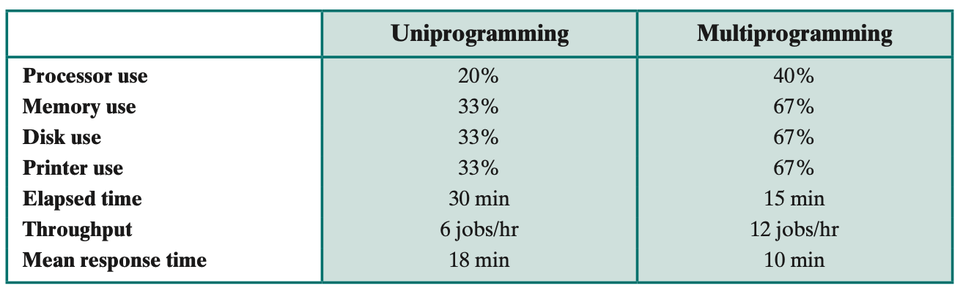
Layered View of a Computer System
Hardware → OS Kernel → OS Utilities → Applications → User — the OS is the abstraction layer between hardware and software (Stallings Fig. 2.1)
SENG 21213 · Computer Architecture & Operating Systems
4

Slide 5
Three Core OS Objectives
Objective | Description | Without It…
Convenience | Hides hardware complexity — provides files instead of disk sectors; sockets instead of frames; processes instead of raw CPU | Programmers would write hardware-specific drivers for every application — not portable, brittle, slow to develop
Efficiency | Maximises CPU utilisation (multiprogramming), memory throughput (virtual memory), I/O bandwidth (DMA, buffering) | Resources idle; one process monopolises CPU while others wait; memory wasted on inactive data
Ability to Evolve | Supports new hardware, services, and bug fixes without breaking existing applications. Stable ABIs allow software to survive kernel upgrades | Every hardware change or kernel bug fix requires rewriting all applications
SENG 21213 · Computer Architecture & Operating Systems
5

Slide 6
Seven OS Services
Service | Description
Program Development | Editors, compilers, debuggers, linkers — the toolchain is part of the OS environment
Program Execution | OS loads code+data into RAM, initialises stack and PCB, dispatches process to CPU
I/O Device Access | Uniform read/write interface — programmers don't need 200-page device specs
Controlled File Access | Understands file system structure; enforces r/w/x permissions for multi-user safety
System Access Control | Mediates access; resolves resource contention; enforces quotas and authentication
Error Detection & Response | Handles parity/ECC errors, divide-by-zero, segfaults — recovers or terminates gracefully
Accounting | Tracks per-process CPU time, memory, I/O for billing, performance analysis, optimisation
SENG 21213 · Computer Architecture & Operating Systems
6

Slide 7
Section 2
System Interface Layers
7

Slide 8
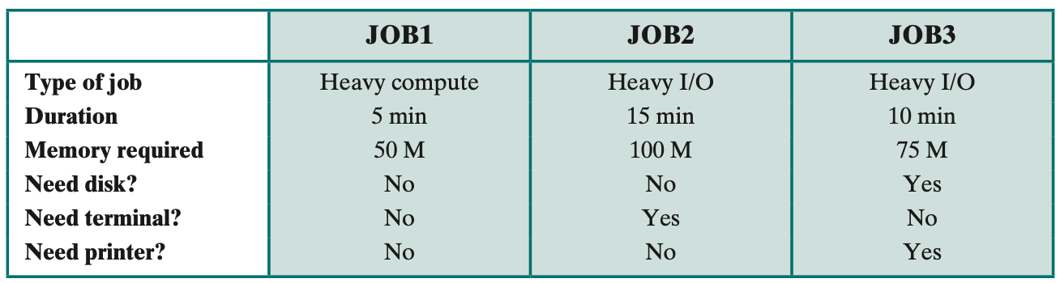
ISA, ABI, and API Interface Layers
ISA between hardware and software; ABI between OS and user programs; API between libraries and applications (Stallings Fig. 2.3)
SENG 21213 · Computer Architecture & Operating Systems
8

Slide 9
ISA vs ABI vs API
Interface | Between | Defines | Enables
ISA | Hardware ↔ Software | Machine instructions, registers, addressing modes, privilege levels | OS and applications to target a processor architecture
ABI | OS Kernel ↔ User applications | System call numbers, calling convention, binary format (ELF/PE), data alignment | A compiled binary to run on any OS version with the same ABI — no recompile
API | Libraries ↔ Application source | High-level function signatures: read(), malloc(), pthread_create() | Same source code to compile on different platforms with compatible APIs
SENG 21213 · Computer Architecture & Operating Systems
9

Slide 10
Section 3
OS Evolution
10

Slide 11
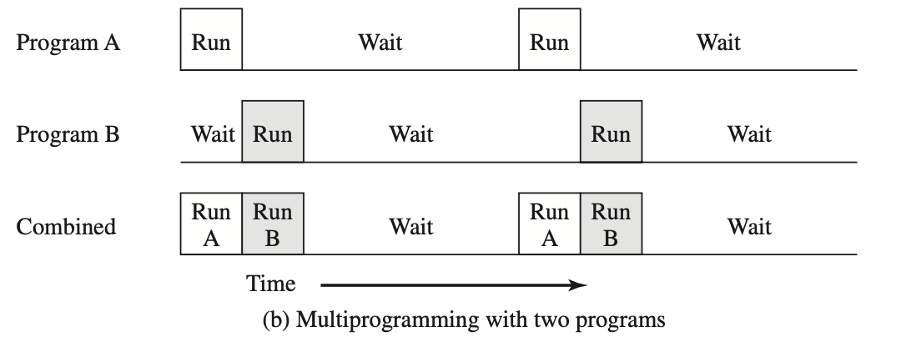
Timeline of OS Evolution
Serial processing → simple batch → multiprogrammed batch → time-sharing — each generation solves the previous generation's waste (Stallings Fig. 2.4)
SENG 21213 · Computer Architecture & Operating Systems
11

Slide 12
OS Evolution — Four Eras
Era | Problem Solved | New Problem Introduced | Key OS Feature
Serial (1940s–50s) | Direct hardware programming | Scheduling waste; human setup time between jobs | None — no OS
Simple Batch (mid-1950s) | Automates job sequencing; Resident Monitor runs next job automatically | CPU idle during I/O: 30–40% utilisation | Resident Monitor, timer interrupt, memory protection
Multiprogrammed (1960s) | Multiple jobs overlap CPU and I/O; CPU rarely idle | Complex memory management; race conditions between jobs | Job scheduler, memory partitioning, interrupt-driven I/O
Time-Sharing (1967+) | Interactive response for multiple users simultaneously (CTSS at MIT, 1961) | Deadlocks, starvation, security between users | Preemptive scheduling, virtual memory, user accounts, file ACLs
SENG 21213 · Computer Architecture & Operating Systems
12

Slide 13
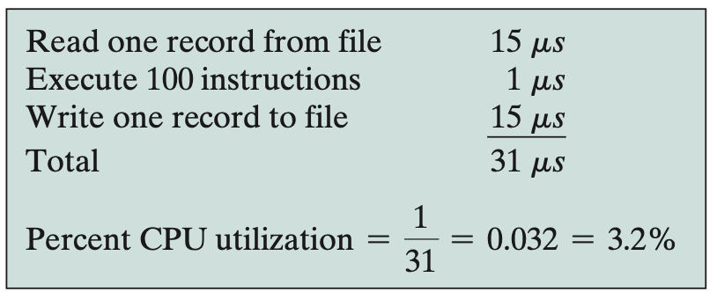
Multiprogramming — CPU Utilisation
Without multiprogramming: CPU idles during I/O. With multiprogramming: CPU switches to Job B while Job A waits for disk — utilisation rises from ~30% to >80% (Stallings Fig. 2.9)
SENG 21213 · Computer Architecture & Operating Systems
13

Slide 14
Section 4
OS as Resource Manager
14

Slide 15
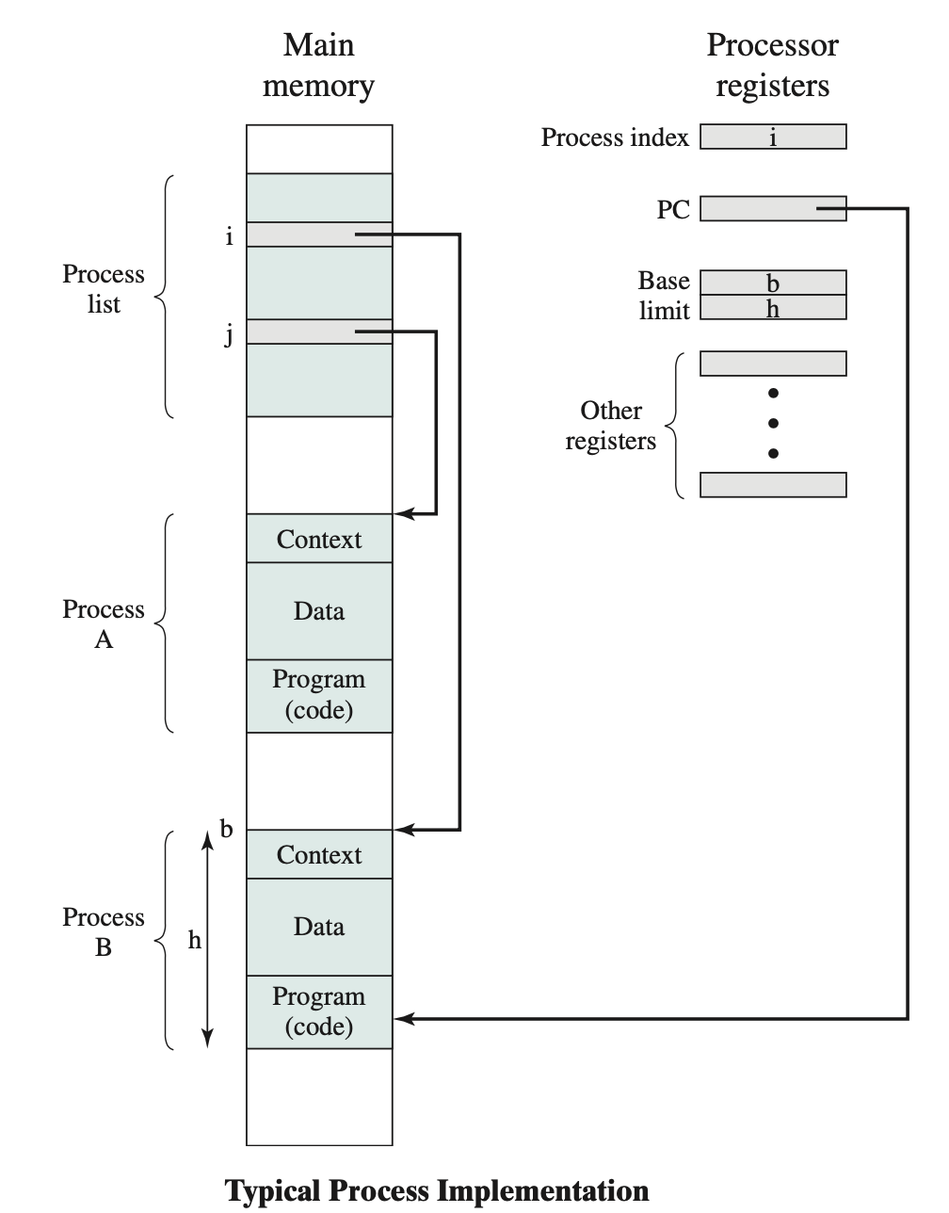
OS Control Tables
Four table types: process table, memory table, I/O table, file table — all cross-referenced from the process table (Stallings Fig. 3.4)
SENG 21213 · Computer Architecture & Operating Systems
15

Slide 16
Four OS Control Table Types
Table | Contents | Role
Process Table | One entry per process: pointer to PCB, PID, state | Master index — all other tables are cross-referenced from here
Memory Tables | Virtual→physical maps; page tables; segment bounds; protection bits | Tracks allocated memory; enforces process isolation
I/O Tables | Device allocation; current operation status; data buffer addresses | Prevents simultaneous device use; queues pending I/O requests
File Tables | Open files: inode pointer, size, type, access mode, permissions | Tracks all open files; per-process file descriptor table points here
SENG 21213 · Computer Architecture & Operating Systems
16

Slide 17
OS Assignment — Stage 0
★ Stage 0: Boot + VGA Driver + Shell
boot/boot.asm: 512-byte MBR. Loads 64 disk sectors (32 KB) using INT 0x13 extended read. Sets up 3-entry GDT. Sets CR0 bit 0. FAR JMP to Protected Mode.
kernel/kernel_entry.asm: loads DS/ES/SS=0x10 (data selector); ESP=0x90000; calls kernel_main().
kernel/kernel.c: vga_init(); kb_init(); splash screen; shell loop → kb_readline() + parse_command().
kernel/vga.c: 80×25 VGA text mode. vga_write_char(row,col,ch,colour). VGA buffer at 0xB8000. Each cell = 2 bytes (ASCII + colour attribute byte).
kernel/keyboard.c: PS/2 poll port 0x60; scancode_to_ascii[] table; kb_getchar(); kb_readline().
Test: make run → QEMU boots; SENG OS splash screen appears → Stage 0 complete!
SENG 21213 · Computer Architecture & Operating Systems
17

Slide 18
Practice Exercise
✎ Exercise 8.1 — OS Services [10 marks]
(a) [3] Identify the OS service for each: (i) web browser opens TCP socket, (ii) C program calls printf(), (iii) process divides by zero.
(b) [4] Running bare-metal without an OS, a programmer wants to read from a disk file. List at least 5 low-level steps they must implement. How does this demonstrate the 'convenience' objective?
(c) [3] A compiled binary runs on Linux x86-64 but fails on Windows x86-64. Which interface layer (ISA, ABI, or API) is the incompatibility at? Which system calls differ? How would a statically-linked binary with its own syscall implementation behave?
SENG 21213 · Computer Architecture & Operating Systems
18

Slide 19
Key Takeaways
OS Overview & Process Models
Three objectives: Convenience (abstractions), Efficiency (resource utilisation), Evolvability (stable ABI)
Seven services: development, execution, I/O, files, access control, error handling, accounting
ISA: hardware↔software. ABI: kernel↔binary. API: library↔source code
Evolution: serial → batch → multiprogrammed (CPU+I/O overlap) → time-sharing (interactive)
Four control tables: process (master), memory (maps), I/O (devices), files (open files)
Stage 0: boot.asm → Protected Mode → kernel_main() → VGA + keyboard shell
19

