Slide 1
Lecture 09
Process Description & Control
PCB · Process States · State Models · Context Switch · CPU Scheduling
SENG 21213 · Computer Architecture & Operating Systems
1

Slide 2
Learning Objectives
By the end of this lecture you should be able to:
1. List and explain all eight PCB field groups and justify why each is necessary
2. Draw the five-state and seven-state process models with all transitions and triggering events
3. Trace the seven-step context switch procedure identifying what is saved, where, and when
4. Apply FCFS, SJF, SRTF, Round-Robin, and Priority scheduling algorithms to a process set
5. Compute average waiting time and turnaround time for each scheduling algorithm
6. Describe Stage 1 implementation requirements for the OS assignment
SENG 21213 · Computer Architecture & Operating Systems
2

Slide 3
Section 1
The Process Control Block (PCB)
3

Slide 4
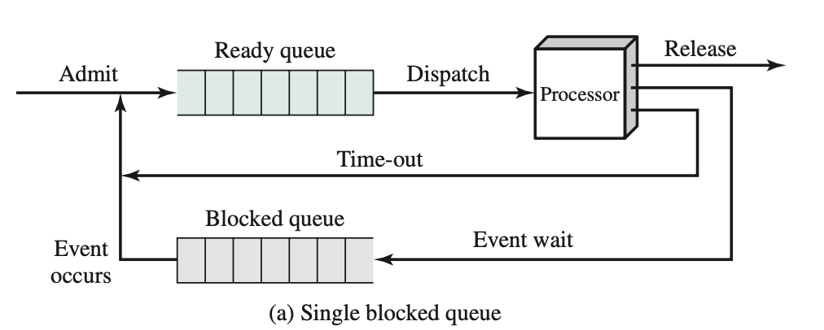
PCB Structure
PCB contains three groups: identification fields, processor state information, and process control information (Stallings Fig. 3.3)
SENG 21213 · Computer Architecture & Operating Systems
4

Slide 5
Eight PCB Field Groups
Field Group | Contents | Why Needed
Process Identifier | PID (unique int), PPID, UID, GID | Cross-references all OS tables; used by wait(), kill(), nice()
Processor State | ALL CPU registers: PC(EIP), EFLAGS, EAX–EDI, ESP, EBP, FPU state | Exact values to RESUME execution after a context switch
Process State | New / Ready / Running / Blocked / Exit — current state | Determines which queue the process belongs to
Priority | Static or dynamic scheduling priority level | Short-term scheduler uses this to select next process to run
Memory Pointers | Pointers to code, data, heap, shared memory segments | OS needs these to restore virtual address space on dispatch
Context Data | Complete register snapshot at most recent context switch | Enables transparent resume — registers restored from here
I/O Status | Pending I/O requests; assigned devices; open file descriptor table | Tracks what I/O the process waits for; unblocks on completion
Accounting | CPU time used; real time elapsed; memory high-water mark; page faults | Used for scheduling, billing, performance analysis
SENG 21213 · Computer Architecture & Operating Systems
5

Slide 6
Section 2
Process State Models
6

Slide 7
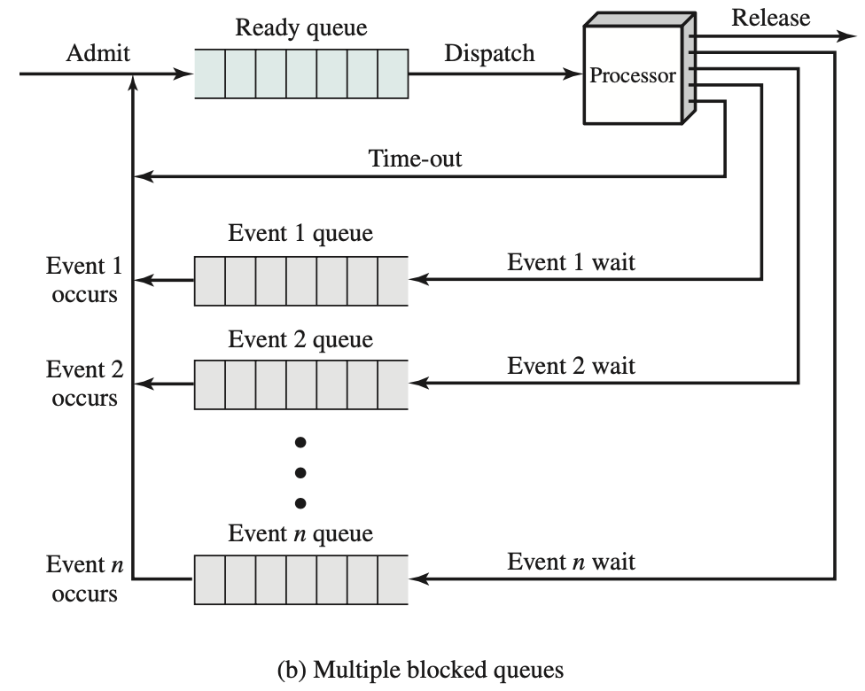
Five-State Process Model
All five states and all nine valid transitions — key exam diagram (Stallings Fig. 3.6)
SENG 21213 · Computer Architecture & Operating Systems
7

Slide 8
Five-State Model — States and Transitions
State | Description
New | PCB allocated; resources assigned; not yet admitted to ready pool
Ready | In main memory with all resources — waiting only for a CPU time slot. Ready queue holds all Ready processes.
Running | Currently executing on a CPU. On uniprocessor: exactly ONE process is Running at any time.
Blocked / Waiting | Cannot proceed — waiting for I/O, semaphore, or child exit. CPU is free but this process cannot use it.
Exit / Zombie | Finished (normal return, exit(), or kill). PCB held briefly for parent to collect exit status; then freed.
SENG 21213 · Computer Architecture & Operating Systems
8

Slide 9
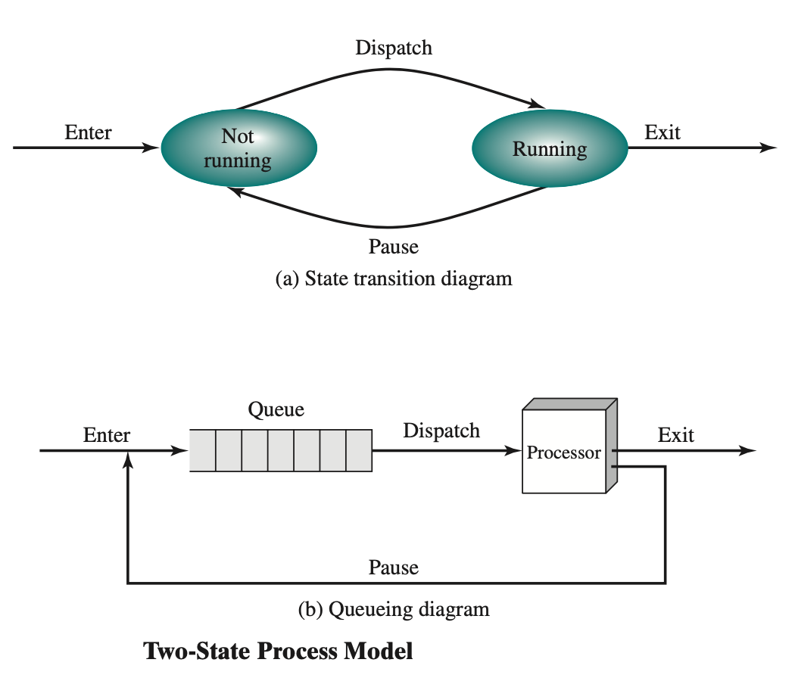
Seven-State Model — Adding Swapping
Seven-state model: Blocked/Suspend and Ready/Suspend states allow OS to swap blocked processes to disk, freeing memory (Stallings Fig. 3.8)
SENG 21213 · Computer Architecture & Operating Systems
9

Slide 10
Section 3
Context Switch
10

Slide 11
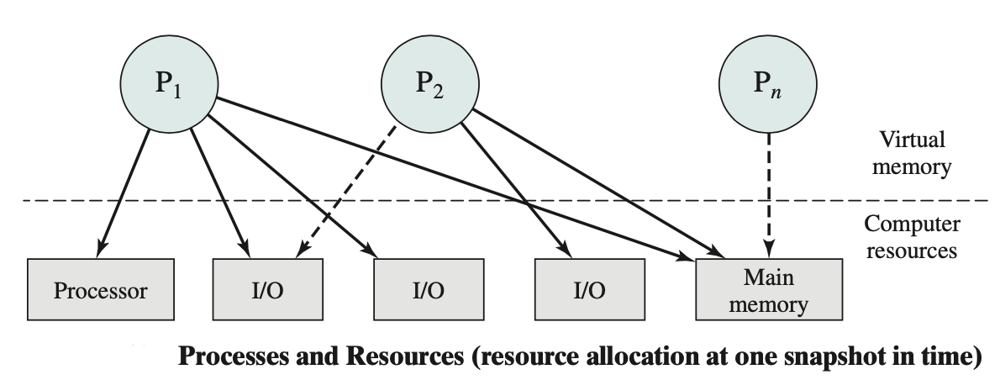
User Mode vs. Kernel Mode
Ring 0 (kernel) vs Ring 3 (user) — system calls and interrupts cause transitions; CPU switches privilege level and stack (Stallings Fig. 3.12)
SENG 21213 · Computer Architecture & Operating Systems
11

Slide 12
Context Switch — Seven Steps
1. Save context of CURRENT process: PC, all registers (EAX–EBP, EFLAGS, FPU) → PCB
2. Update current PCB: state → Ready (preemption) or Blocked (I/O wait); update CPU accounting
3. Move current PCB to appropriate queue (ready queue or blocked-on-event queue)
4. Run short-term scheduler: select next process from ready queue (scheduling algorithm)
5. Update selected PCB: state → Running; record dispatch timestamp for accounting
6. Update memory: load CR3 with new process's page table base (flushes TLB on x86)
7. Restore context: load all registers from selected PCB (EAX…EBP, ESP, EIP, EFLAGS); CPU resumes
SENG 21213 · Computer Architecture & Operating Systems
12

Slide 13
Context Switch Cost
⚠ Why Context Switches Are Expensive
Direct cost: save/restore all CPU registers (EAX–EDI, FPU/SSE state = 512+ bytes)
TLB flush: CR3 load invalidates ALL TLB entries → next 100s of memory accesses hit page table
Cache pollution: new process's working set displaces current process from L1/L2 cache
Total cost: 1–100 µs depending on architecture, register count, TLB size, cache size
Round-Robin Q=50ms: 5µs switch / 50ms quantum = 0.01% overhead (acceptable)
Round-Robin Q=1ms: 5µs switch / 1ms quantum = 0.5% overhead (significant!)
SENG 21213 · Computer Architecture & Operating Systems
13

Slide 14
Section 4
CPU Scheduling Algorithms
14

Slide 15
Five Scheduling Algorithms
Algorithm | Selection Rule | Preemptive? | Problem | Best For
FCFS | First to arrive, first to run | No | Convoy effect: short jobs stuck behind long ones | Simple batch
SJF | Shortest CPU burst next | No | Starvation of long jobs; needs burst prediction | Minimise average wait (non-preemptive optimal)
SRTF | Shortest REMAINING burst | Yes | High overhead; needs burst prediction | Optimal average wait (preemptive)
Round-Robin | Circular queue; fixed quantum Q | Yes | High context switch overhead if Q too small | Time-sharing; fair; interactive systems
Priority | Highest priority first (static or dynamic) | Both | Starvation → fix with ageing (raise priority over time) | Real-time; mixed workloads
SENG 21213 · Computer Architecture & Operating Systems
15

Slide 16
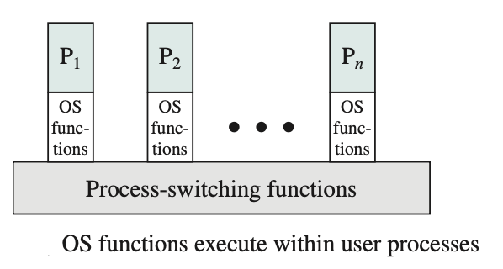
Round-Robin Scheduling Example (Q=4 ms)
P1(10ms), P2(6ms), P3(4ms) all arrive t=0. Order: P1(0–4)→P2(4–8)→P3(8–12)→P1(12–16)→P2(16–18)→P1(18–20). Average turnaround = 16.7ms (Stallings Fig. 9.5)
SENG 21213 · Computer Architecture & Operating Systems
16

Slide 17
Round-Robin Calculation
★ RR with Q=4: P1(10ms), P2(6ms), P3(4ms)
Schedule: P1(0–4) → P2(4–8) → P3(8–12) → P1(12–16) → P2(16–18) → P1(18–20)
Completion times: P3=12ms, P2=18ms, P1=20ms
Turnaround: P3=12, P2=18, P1=20 → Average = (12+18+20)/3 = 16.7 ms
Waiting time: P3=12−4=8, P2=18−6=12, P1=20−10=10 → Average = (8+12+10)/3 = 10 ms
Context switches: 5 (one between each time slice)
Effect of smaller Q: better response time but more context switch overhead — classic trade-off
SENG 21213 · Computer Architecture & Operating Systems
17

Slide 18
OS Assignment — Stage 1
★ Milestone 1: Process Table + Round-Robin Scheduler
process.h: typedef struct { int pid; int state; uint32_t esp; uint32_t eip; int priority; char name[32]; } pcb_t;
process.c: create_process(name, entry, priority): allocate 4KB stack; init PCB; set eip=entry; state=READY; add to process_table[].
scheduler.c: schedule(): save ESP of current into PCB; find next READY (round-robin); load ESP from next PCB.
switch.asm: context_switch(cur, next): PUSHAD; save ESP→cur; load ESP←next; POPAD; RET.
irq.c: Program PIT (8253) via ports 0x40–0x43 for 100 Hz clock. IRQ0 handler calls schedule().
Shell: 'ps' command lists all PCBs — PID, name, state, priority.
SENG 21213 · Computer Architecture & Operating Systems
18

Slide 19
Practice Exercise
✎ Exercise 9.2 — CPU Scheduling [14 marks]
Five processes: P1(8ms,t=0), P2(4ms,t=1), P3(9ms,t=2), P4(5ms,t=3), P5(2ms,t=4).
(a) [6] Draw Gantt chart and calculate avg turnaround + avg waiting for: (i) FCFS, (ii) SJF non-preemptive, (iii) SRTF preemptive.
(b) [4] Apply Round-Robin Q=3ms. Gantt chart, avg turnaround, avg waiting, number of context switches.
(c) [4] Priority scheduling with ageing: P3 has waited 20ms; ageing adds 1 priority per 5ms. What is P3's effective priority? Which process could starve without ageing?
SENG 21213 · Computer Architecture & Operating Systems
19

Slide 20
Key Takeaways
Process Description & Control
PCB = OS's complete record of a process: 8 field groups from PID to accounting
Five states: New→Ready→Running→Blocked→Exit. All 9 transitions must be memorised with triggers.
Seven-state adds Ready/Suspend + Blocked/Suspend — OS swaps to disk when all processes blocked
Context switch = 7 steps: save registers → update PCB → scheduler → update CR3 → restore
FCFS: convoy. SJF: optimal non-preemptive. SRTF: optimal preemptive. RR: fair. Priority: starvation risk
Stage 1: PCB struct, create_process(), PIT-driven schedule(), PUSHAD/POPAD context switch
20

