Slide 1
Lecture 10
Threads & Concurrency Control
Threads · ULT vs KLT · Race Conditions · Dijkstra · CAS · Stage 2
SENG 21213 · Computer Architecture & Operating Systems
1

Slide 2
Learning Objectives
By the end of this lecture you should be able to:
1. Define a thread and distinguish process-level resource ownership from thread-level execution
2. Compare ULT and KLT on 8 attributes including blocking, multi-core use, and context-switch cost
3. Analyse the myglobal race condition, identify the non-atomic READ-MODIFY-WRITE, and apply a mutex fix
4. Describe the three types of process interaction and the hazards associated with each
5. State all six Dijkstra requirements for mutual exclusion and evaluate a given mechanism against them
6. Explain Compare-and-Swap (CAS) and XCHG hardware mutual exclusion and their three drawbacks
SENG 21213 · Computer Architecture & Operating Systems
2

Slide 3
Section 1
Threads and Multithreading
3

Slide 4
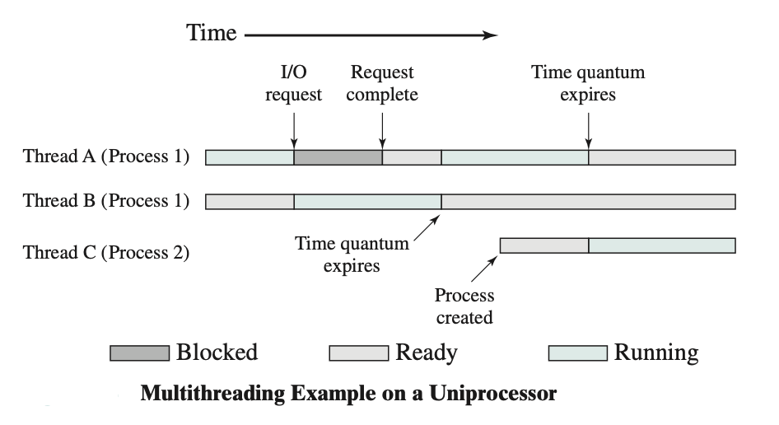
Single-threaded vs. Multi-threaded Process
Threads share code, data, heap, and open files. Each thread has its own stack and program counter (Stallings Fig. 4.1)
SENG 21213 · Computer Architecture & Operating Systems
4

Slide 5
Process Characteristics Split Between Process and Thread
Process Level (Resource Ownership)
Thread Level (Scheduling / Execution)
Virtual address space (code, data, heap)
Open file descriptor table
I/O device handles
IPC channels (pipes, sockets)
Shared memory regions
ONE per process — all threads share
Program counter (EIP)
CPU registers (EAX–EFLAGS)
Stack (separate per thread)
Thread state (Running/Ready/Blocked)
Thread-local storage (TLS)
ONE per thread — independently scheduled
SENG 21213 · Computer Architecture & Operating Systems
5

Slide 6
Benefits of Multithreading
Benefit | Description | Example
Responsiveness | One thread blocks on I/O; another continues serving user | Browser: download thread + render thread + UI thread
Resource Sharing | Threads share process memory — no IPC needed for inter-thread comms | Server: all workers share connection pool without copying
Economy | Thread creation 10–100× cheaper than fork(); context switch 5–10× faster | Web server: thread per request is feasible; fork per request is not
Multi-core Utilisation | Multiple threads run in TRUE parallel on separate cores | 4-thread matrix multiply uses all 4 cores; single-threaded uses 1
Modularity | Decompose app into concurrent activities: I/O, compute, GUI threads | Media player: decode + render + audio threads independently tuned
SENG 21213 · Computer Architecture & Operating Systems
6

Slide 7
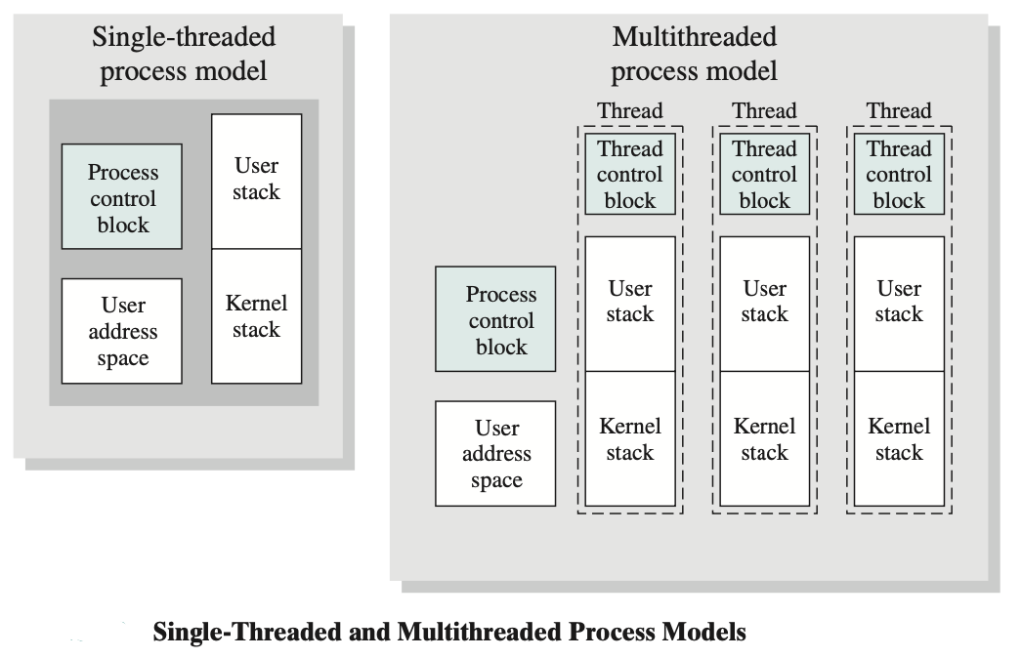
ULT vs. KLT Models
ULT: many threads managed by user-space library, kernel sees one thread. KLT: kernel manages threads directly, supports true parallelism (Stallings Fig. 4.5)
SENG 21213 · Computer Architecture & Operating Systems
7

Slide 8
ULT vs. KLT — Eight Attributes
Attribute | ULT (User-Level Threads) | KLT (Kernel-Level Threads)
Who manages | Thread library — no kernel | OS kernel — system calls for all operations
Context switch cost | Very fast — no kernel mode transition | Slower — requires syscall trap (~1 µs)
One thread blocks | ENTIRE PROCESS blocks — kernel sees only 1 thread | Other threads in process continue running
Multi-core use | NO — process on one core only | YES — kernel schedules threads on different cores
Portability | Works without kernel thread support | Tied to OS API (pthreads, Win32)
Signal delivery | Delivered to process; library routes it | Delivered directly to specific thread
Examples | Early Java green threads, early Ruby MRI | Linux NPTL pthreads, Windows threads, macOS GCD
Modern hybrid | N:M — M kernel threads serve N user threads (Go goroutines) | —
SENG 21213 · Computer Architecture & Operating Systems
8

Slide 9
Section 2
Race Conditions
9

Slide 10
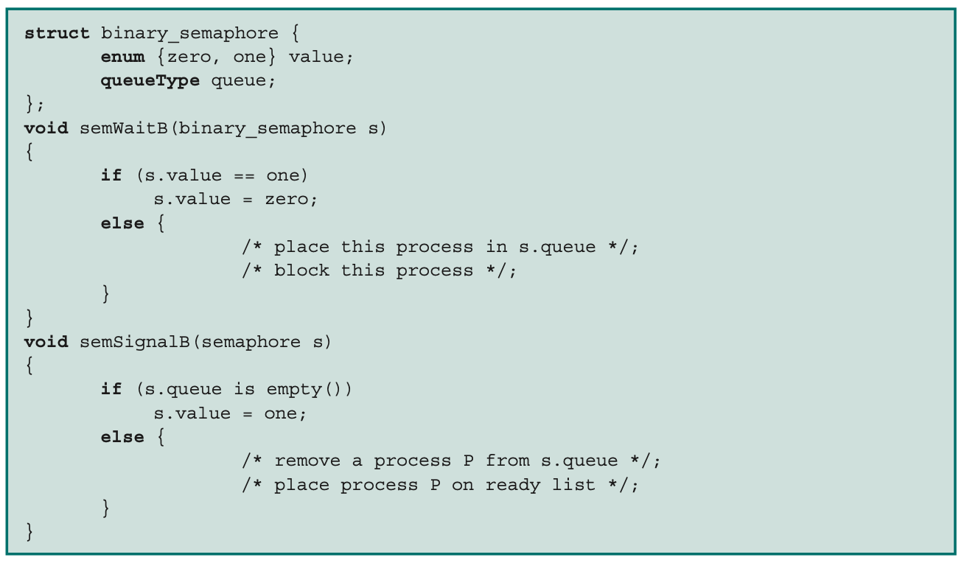
Echo Shared Variable Problem
Two concurrent calls to echo() share global variable chin — P1 reads chin then P2 overwrites before P1 outputs: P1 outputs wrong character (Stallings Fig. 5.1)
SENG 21213 · Computer Architecture & Operating Systems
10

Slide 11
myglobal Race Condition
C
int myglobal = 0; /* SHARED — no protection! */
pthread_mutex_t lock = PTHREAD_MUTEX_INITIALIZER;
void *thread_fn(void *arg) {
int i, j;
for (i = 0; i < 20; i++) {
/* UNSAFE: READ-MODIFY-WRITE is not atomic! */
j = myglobal; /* (1) READ — preemption can happen here */
j = j + 1; /* (2) increment local copy */
sleep(1); /* very likely preempted here */
myglobal = j; /* (3) WRITE — may overwrite other thread! */
/* SAFE version (use this instead): */
/* pthread_mutex_lock(&lock); */
/* myglobal++; ← only one thread at a time */
/* pthread_mutex_unlock(&lock); */
}
return NULL;
}
/* Expected: 40. Without mutex: often 20–39 (lost updates) */
SENG 21213 · Computer Architecture & Operating Systems
11

Slide 12
Three Types of Process Interaction
Type | Description | Problems Caused
Unaware of each other | Independent processes compete for same resources (CPU, disk, printer) without knowing each other exist | Mutual exclusion (access to non-shareable resources), Deadlock, Starvation
Indirectly aware | Processes share a common object (buffer, table, file) without explicitly cooperating | Mutual exclusion, Deadlock, Starvation, Data coherence (stale reads)
Directly aware | Explicit communication by PID using IPC (pipes, messages, signals, sockets) — designed to cooperate | Deadlock (each waiting for message from the other), Starvation (one source dominates)
SENG 21213 · Computer Architecture & Operating Systems
12

Slide 13
Section 3
Mutual Exclusion — Requirements & Hardware
13

Slide 14
Dijkstra's Six Requirements for Mutual Exclusion
# | Requirement | Description
1 | Mutual Exclusion | Only ONE process at a time may be in its critical section for a given resource
2 | Non-interference | A process halted OUTSIDE its critical section must not block others from entering
3 | No deadlock/starvation | No set of processes may be indefinitely prevented from entering their critical section
4 | Progress | If no process is in the CS, any requesting process must eventually be allowed in
5 | No speed assumptions | Must work regardless of relative process speeds or number of processors
6 | Finite time inside | A process stays in its critical section for a finite, bounded time only
SENG 21213 · Computer Architecture & Operating Systems
14

Slide 15
Compare-and-Swap (CAS) — Hardware Mutual Exclusion
C
/* CAS: atomic test-and-set — hardware executes as ONE uninterruptible op */
int compare_and_swap(int *word, int testval, int newval) {
int oldval = *word;
if (oldval == testval) *word = newval; /* bus is LOCKED during this */
return oldval;
}
int lock = 0; /* 0 = unlocked, 1 = locked */
void acquire_lock() {
while (compare_and_swap(&lock, 0, 1) != 0) /* SPIN */
; /* CPU burns cycles here — acceptable only for < 1 µs waits */
}
void release_lock() { lock = 0; }
/* x86: LOCK CMPXCHG implements CAS atomically */
/* XCHG always has implicit LOCK prefix on x86 */
SENG 21213 · Computer Architecture & Operating Systems
15

Slide 16
Hardware Mutual Exclusion Drawbacks
⚠ Three Problems with Spinlocks
1. Busy waiting: Process burns CPU cycles checking the lock — wastes resources during contention
Solution: use blocking (semaphore/mutex) for critical sections longer than ~1 µs
2. Starvation: Multiple spinners — which one wins the CAS is non-deterministic; one could wait forever
Solution: queue-based spinlock (MCS lock) — fair FIFO ordering of waiters
3. Priority inversion: Low-priority L holds lock; high-priority H spins (occupying CPU). L can't run to release.
Solution: Priority inheritance — OS temporarily boosts L's priority to H's level until lock released
SENG 21213 · Computer Architecture & Operating Systems
16

Slide 17
OS Assignment — Stage 2
★ Milestone 2: Threads + Mutex + Semaphore
thread.h: typedef struct { int tid; int state; uint32_t esp; uint32_t eip; pcb_t *parent; uint32_t stack[1024]; } thread_t;
thread.c: create_thread(entry, parent): allocate thread_t, init stack (push entry addr), add to parent->thread_list.
mutex.c: mutex_t {int locked; thread_t *waitq;}. mutex_lock: if locked → block current thread; else locked=1. mutex_unlock: if waitq → wakeup(dequeue(waitq)); else locked=0.
semaphore.c: sem_t {int count; thread_t *waitq;}. sem_wait: count--; if count<0 block(). sem_signal: count++; if count<=0 wakeup(dequeue(waitq)).
Test 1: myglobal race — without mutex (wrong count), with mutex (count=40).
Test 2: Producer-consumer with buffer size 5 using 3 semaphores (n, e, s).
SENG 21213 · Computer Architecture & Operating Systems
17

Slide 18
Practice Exercise
✎ Exercise 10.2 — Race Conditions [14 marks]
Two threads share int x=0, int y=0: Thread 1: x=1; r1=y; Thread 2: y=1; r2=x;
(a) [4] List ALL possible (r1,r2) values. Which is impossible? What ordering prevents it?
(b) [2] Can (0,0) occur on a single-processor with context switches only? On multi-core? Name the hardware phenomenon enabling it.
(c) [4] Apply Dijkstra's 6 requirements to Peterson's Algorithm. Which does it satisfy? Which (if any) does it fail?
(d) [4] Evaluate CAS spinlock against Dijkstra's requirements. Which requirement(s) does it FAIL? Propose a fix.
SENG 21213 · Computer Architecture & Operating Systems
18

Slide 19
Key Takeaways
Threads & Concurrency Control
Thread = execution path within a process. Shares code/heap/files; has own stack/PC/registers.
ULT: fast switch, no multi-core, whole process blocks on I/O. KLT: slower switch, true parallelism.
Race condition: READ-MODIFY-WRITE is not atomic — any preemption between steps corrupts shared state
Fix: mutex wraps the critical section → only one thread executes inside at a time
Dijkstra's 6: mutual exclusion, non-interference, no deadlock/starvation, progress, no speed assumption, bounded time
CAS/XCHG: atomic hardware — but three drawbacks: busy-wait, starvation, priority inversion
19

