Slide 1
Lecture 11
Semaphores, Deadlocks & Memory Management
Semaphores · Producer-Consumer · Deadlock · Coffman · Banker's · Paging
SENG 21213 · Computer Architecture & Operating Systems
1

Slide 2
Learning Objectives
By the end of this lecture you should be able to:
1. Implement semaphore operations (semWait/semSignal) and explain the count semantics
2. Distinguish mutex from binary semaphore by ownership rules and use cases
3. Write the three-semaphore producer-consumer solution and explain the critical ordering rule
4. State all four Coffman conditions and describe a prevention strategy and trade-off for each
5. Apply the Banker's Algorithm safety check and request-grant procedure to a given state
6. Trace FIFO, LRU, and OPT page replacement for a reference string and count page faults
SENG 21213 · Computer Architecture & Operating Systems
2

Slide 3
Section 1
Semaphores
3

Slide 4
semWait and semSignal — Blocking Implementation
C
struct semaphore { int count; queue_t waiting; };
/* semWait (P / down): try to acquire */
void semWait(semaphore *s) {
s->count--;
if (s->count < 0) { /* negative count = |count| waiters */
add_to_queue(s->waiting, current_process);
block(); /* remove from ready queue; context switch */
}
}
/* semSignal (V / up): release one waiter */
void semSignal(semaphore *s) {
s->count++;
if (s->count <= 0) { /* at least one process waiting */
pcb_t *p = dequeue(s->waiting);
wakeup(p); /* move p to ready queue */
}
}
/* MUST be atomic — implement with interrupts disabled or test-and-set */
SENG 21213 · Computer Architecture & Operating Systems
4

Slide 5
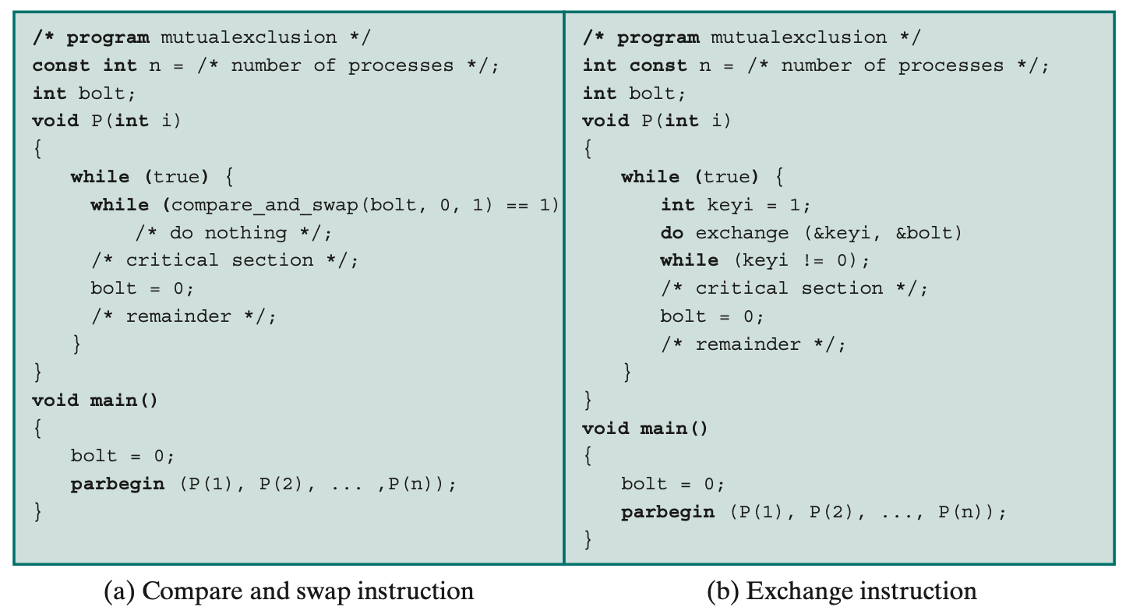
Semaphore Operation Trace
Counting semaphore trace: 3 processes calling semWait and semSignal — tracking count value and wait queue length at each step (Stallings Fig. 5.11)
SENG 21213 · Computer Architecture & Operating Systems
5

Slide 6
Mutex vs. Binary Semaphore
Mutex (Mutual Exclusion Lock)
Binary Semaphore
Ownership: ONLY the thread that locked it can unlock it
Use case: protecting a critical section entered and exited by the SAME thread
Recursive mutex: same thread can lock multiple times (counts locks)
Priority inheritance: OS can boost holder's priority to prevent priority inversion
Example: pthread_mutex_t in Linux NPTL
No ownership: ANY thread can signal, regardless of who waited
Use case: signalling between threads — consumer waits, producer signals
Not recursive — second wait by same thread blocks if count=0
Priority inheritance not typically supported
Example: sem_t (POSIX semaphore), Dijkstra original
SENG 21213 · Computer Architecture & Operating Systems
6

Slide 7
Producer-Consumer — Three Semaphores
C
/* n = items available; e = empty slots; s = binary mutex */
semaphore n = 0, e = BUFFER_MAX, s = 1;
void producer() {
while (true) {
T = produce();
semWait(e); /* wait for empty slot — blocks if buffer FULL */
semWait(s); /* LOCK buffer — enter critical section */
buffer[in] = T; in = (in+1) % BUFFER_MAX;
semSignal(s); /* UNLOCK buffer */
semSignal(n); /* signal: one more item available */
}
}
void consumer() {
while (true) {
semWait(n); /* wait for item — blocks if buffer EMPTY */
semWait(s); /* LOCK buffer */
T = buffer[out]; out = (out+1) % BUFFER_MAX;
semSignal(s); /* UNLOCK buffer */
semSignal(e); /* signal: one empty slot freed */
consume(T);
}
}
/* CRITICAL: semWait(e) BEFORE semWait(s) — reversed order = deadlock! */
SENG 21213 · Computer Architecture & Operating Systems
7

Slide 8
Critical Ordering Rule
⚠ ⚠ Counting Semaphore BEFORE Mutex — Always!
WRONG order (producer): semWait(s) first, THEN semWait(e)
→ Producer holds mutex s; finds buffer full; blocks on e
→ Consumer cannot acquire mutex s to remove an item
→ DEADLOCK: producer waits for consumer; consumer waits for producer. Neither can proceed.
CORRECT order: semWait(e) first (counting sem), THEN semWait(s) (mutex)
Rule: always acquire the COUNTING/RESOURCE semaphore BEFORE the MUTEX semaphore
SENG 21213 · Computer Architecture & Operating Systems
8

Slide 9
Section 2
Deadlocks
9

Slide 10
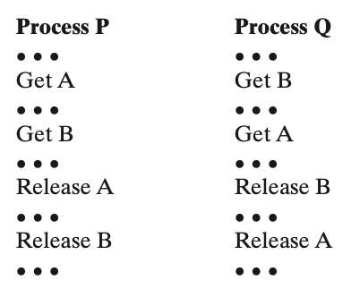
Joint Progress Diagram — The Deadlock Zone
Two processes P and Q competing for resources Ra and Rb. Fatal region: P holds Ra, Q holds Rb — circular wait. Execution paths that enter the shaded region deadlock (Stallings Fig. 6.2)
SENG 21213 · Computer Architecture & Operating Systems
10

Slide 11
Four Coffman Conditions — All Four Must Hold for Deadlock
Condition | Description | Prevention Strategy | Trade-off
1. Mutual Exclusion | At least one resource held non-shareably — one process at a time | Make resources shareable (read-only files; print spooler) | Cannot always share — printers can't share mid-job
2. Hold and Wait | Holds ≥1 resource while waiting to acquire more | All-or-nothing resource request; or release all before re-requesting | Low utilisation; starvation if large resource set hard to acquire simultaneously
3. No Preemption | Resources not forcibly taken — only voluntarily released | OS preempts resources from blocked processes (save+restore state) | Only works for preemptable resources (CPU, memory) — not printers
4. Circular Wait | P1 waits for P2, P2 waits for P3, …, Pn waits for P1 | Total ordering on resource types — all request in increasing order | Some processes request in unnatural order; reduces modularity
SENG 21213 · Computer Architecture & Operating Systems
11

Slide 12
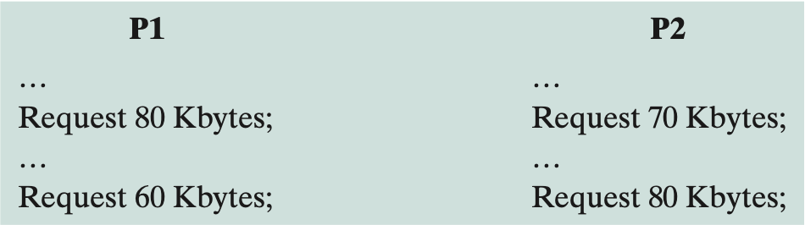
Safe vs. Unsafe State — Banker's Algorithm
Safe state: a sequence exists in which all processes can complete. Unsafe state: deadlock is possible (but not guaranteed). Banker's Algorithm prevents unsafe state transitions (Stallings Fig. 6.7)
SENG 21213 · Computer Architecture & Operating Systems
12

Slide 13
Banker's Algorithm
★ Deadlock Avoidance — Safety Check
Data structures: Allocation[i][j] = units of resource j held by process i
Max[i][j] = maximum units of resource j that process i will ever need
Available[j] = total units of resource j currently unallocated
Need[i][j] = Max[i][j] − Allocation[i][j] (still required)
Safety algorithm: find a process whose Need ≤ Available; simulate it finishing; add its Allocation to Available; repeat.
If all processes can finish: state is SAFE → grant request. Else: UNSAFE → defer.
SENG 21213 · Computer Architecture & Operating Systems
13

Slide 14
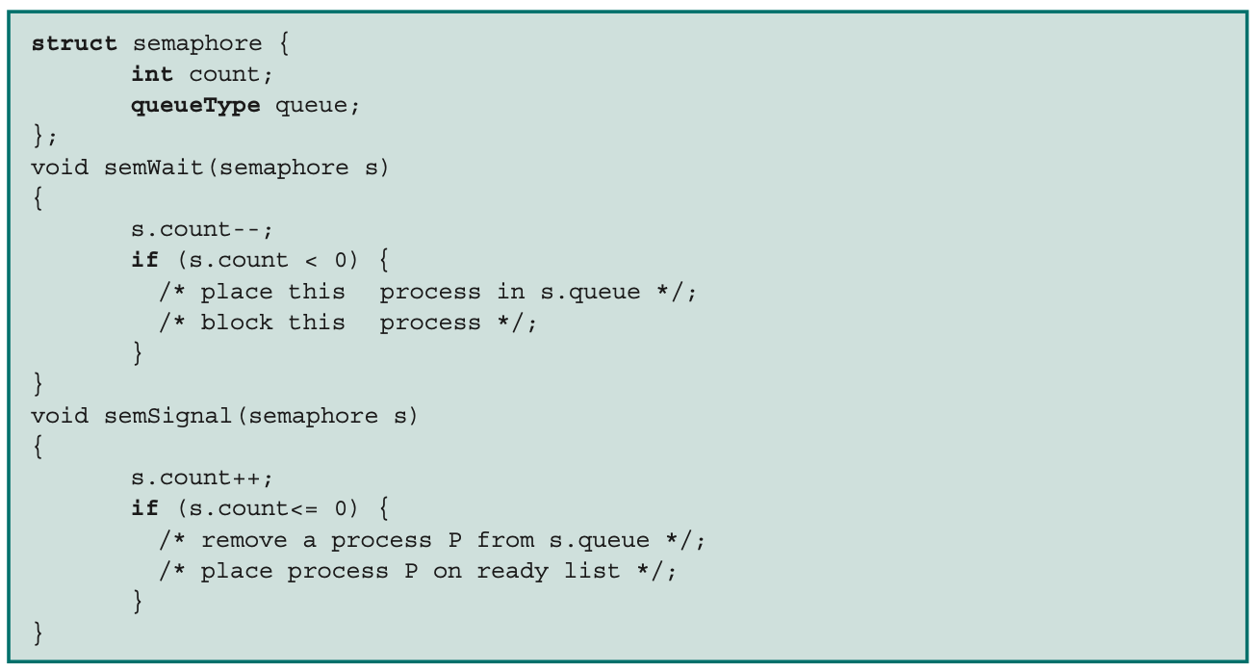
Semaphore Mutual Exclusion — Three Processes
Binary semaphore enforces mutual exclusion among three processes — only one enters critical section at a time; others block in semaphore wait queue (Stallings Fig. 5.15)
SENG 21213 · Computer Architecture & Operating Systems
14

Slide 15
Section 3
Memory Management & Paging
15

Slide 16
Page Replacement Algorithms
Algorithm | Strategy | Belady's Anomaly? | Performance
OPT | Replace page not needed for longest future time — requires future knowledge | No | Optimal — used as benchmark; cannot be implemented in practice
FIFO | Replace the page resident the longest | YES ← exam! | Simple but poor — may evict frequently-used old page
LRU | Replace the page used least recently | No | Near-optimal; expensive to track exactly — hardware approximations used
Clock (Second Chance) | Circular list + reference bit R. Replace first page with R=0; set R=0 as clock sweeps past | No | Good LRU approximation; practical — used in Linux (active/inactive page lists)
LFU | Replace the page accessed least frequently | No | Good for hot pages; may retain dead pages that were popular early
SENG 21213 · Computer Architecture & Operating Systems
16

Slide 17
OS Assignment — Stage 3
★ Milestone 3: Physical Memory Manager (PMM)
pmm.h: void pmm_init(uint32_t memsize); uint32_t pmm_alloc_frame(); void pmm_free_frame(uint32_t addr);
pmm.c: Bitmap — one bit per 4 KB physical frame. Bit=1: frame is used. Bit=0: frame is free.
pmm_init(): mark frames 0 through KERNEL_END/4096 as used (kernel code, stack, PCB area).
pmm_alloc_frame(): scan bitmap for first 0 bit; set it to 1; return frame_number × 4096.
pmm_free_frame(addr): clear bit at addr/4096.
Test: alloc 10 frames, free frames 3 and 7, alloc 2 more → verify 0xC000 and 0x1C000 returned (reuse).
SENG 21213 · Computer Architecture & Operating Systems
17

Slide 18
Practice Exercise
✎ Exercise 11.2 — Banker's Algorithm [12 marks]
4 processes, 3 resource types: R1(3), R2(2), R3(2).
Allocation: P1(1,0,0), P2(0,1,0), P3(1,1,0), P4(0,0,1). Max: P1(3,2,2), P2(0,2,0), P3(1,1,2), P4(0,0,2). Available: (1,0,1).
(a) [4] Apply the Banker's safety algorithm. Is the state safe? If yes, give the safe sequence.
(b) [4] P2 requests (0,1,0). Simulate granting it. Is the new state safe? Should the request be granted?
(c) [4] For each Coffman condition, describe a real-world technique (Linux or Windows) that prevents it.
SENG 21213 · Computer Architecture & Operating Systems
18

Slide 19
Key Takeaways
Semaphores, Deadlocks & Memory Management
Semaphore count: positive = resources available; negative = |count| processes waiting in queue
Mutex: ownership enforced (same thread locks/unlocks). Semaphore: any thread can signal.
Producer-consumer: 3 semaphores (n, e, s). CRITICAL: counting sem BEFORE mutex or DEADLOCK.
Deadlock requires ALL 4 Coffman: mutual exclusion, hold&wait, no preemption, circular wait
Banker's: find safe sequence where each process can complete with Available resources
Page replacement: OPT (optimal benchmark), LRU (best practical), Clock (Linux approximation)
19

